Slide 1
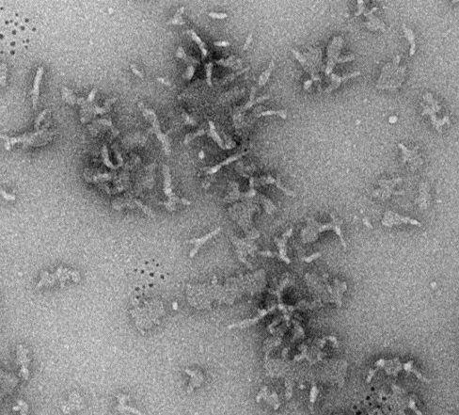
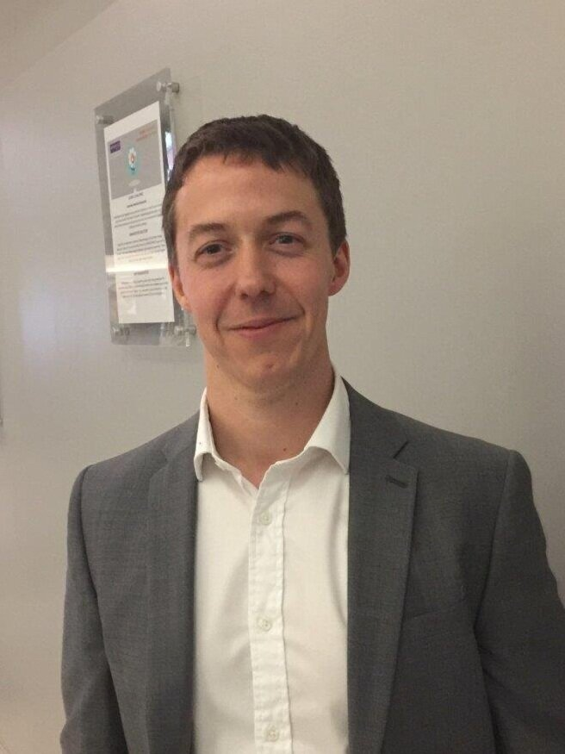
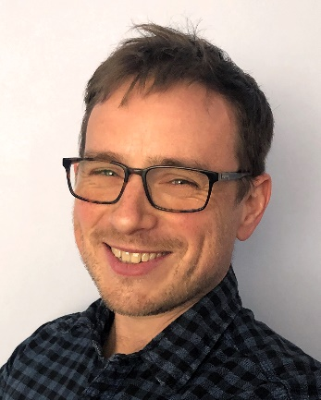
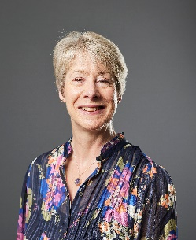
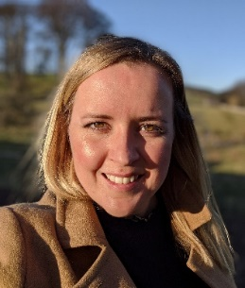
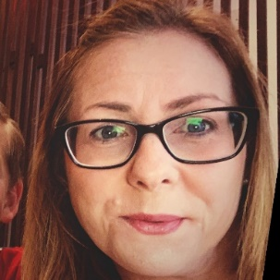
3rd Annual CDT Conference
Talks and posters from all CDT students
Weetwood Hall Estate,
Leeds,
LS16 5PS
12th and 13th July
2023
Guest Speakers:
Professor Anthony Green (University of Manchester)
Dr Graham Newton (University of Nottingham)
Career panel discussion
. .
. .
Register here

Slide 2
Conference Programme
Day 1: Wednesday 12th July 2023
9.30 – 10.15 | Welcome and Registration
10:15 – 10:45 | Introduction | Dr Pete Dowding
10:45 – 11:35 | Session 1 | (Student names)
11:35 – 11:45 | Coffee
11:45 – 12:35 | Session 2 | (Student names)
12:35 – 13:30 | Lunch
13:20 – 14:10 | Session 3 | (Student names)
14:10 – 14:55 | Academic Talk 1
14:55 – 15:10 | Cohort 4 Flash Presentations | (Student names)
15:10 – 16:00 | Poster Session 1
16:00 – 16:45 | Academic Talk 2
16:45 – 17:00 | Wrap Up Day 1
19:00 | Dinner – Sponsored by Infineum

Slide 3
Conference Programme
Day 2: Thursday 13th July 2023
9:30 – 10:20 | Session 4 | (Student names)
10:20 – 11:10 | Session 5 | (Student names)
11:10 – 11:20 | Coffee
11:20 – 12:30 | Session 6 | (Student names)
12:30 – 12:45 | Cohort 4 Flash Presentations | (Student names)
12:45 – 13:30 | Lunch
13:30 – 15:00 | Panel Session | Dr Helen Blade(AZ) Dr Rachael Shinebaum (AZ) Dr Ceri Williams Dr Charlotte Bell
15:00 – 15:50 | Poster Session 2
15:50 – 16:00 | Wrap Up Day 2 & Prize Giving
16:00 | End
Organising Committee
Academics
Students

